Slide 1
BD LAB INTERNALS
Pavithra n
Int18is109
Batch 2 (question paper set 1)

Slide 2
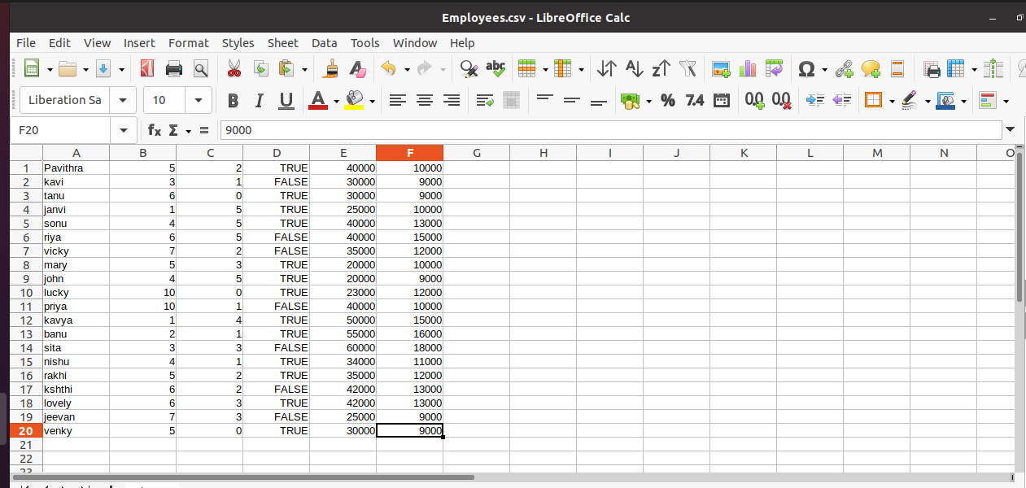
DATASET OF 20 REcords

Slide 3
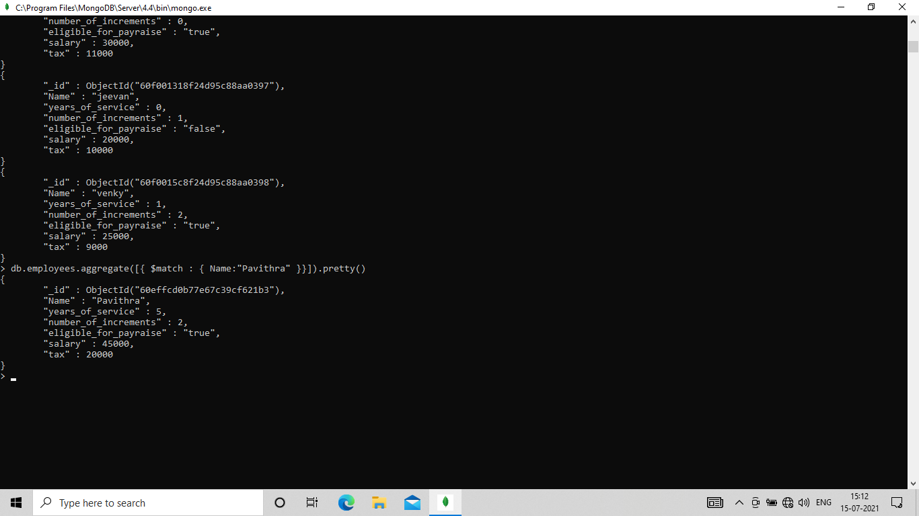
MONGODB 1) Demonstrate the usage of $match, $group, aggregate pipelines.

Slide 4
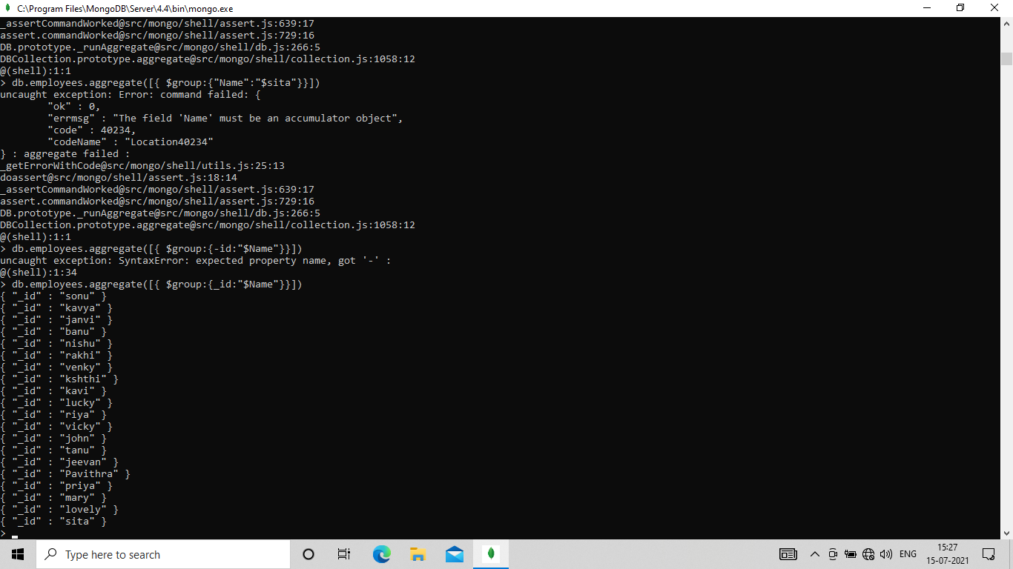
$group

Slide 5
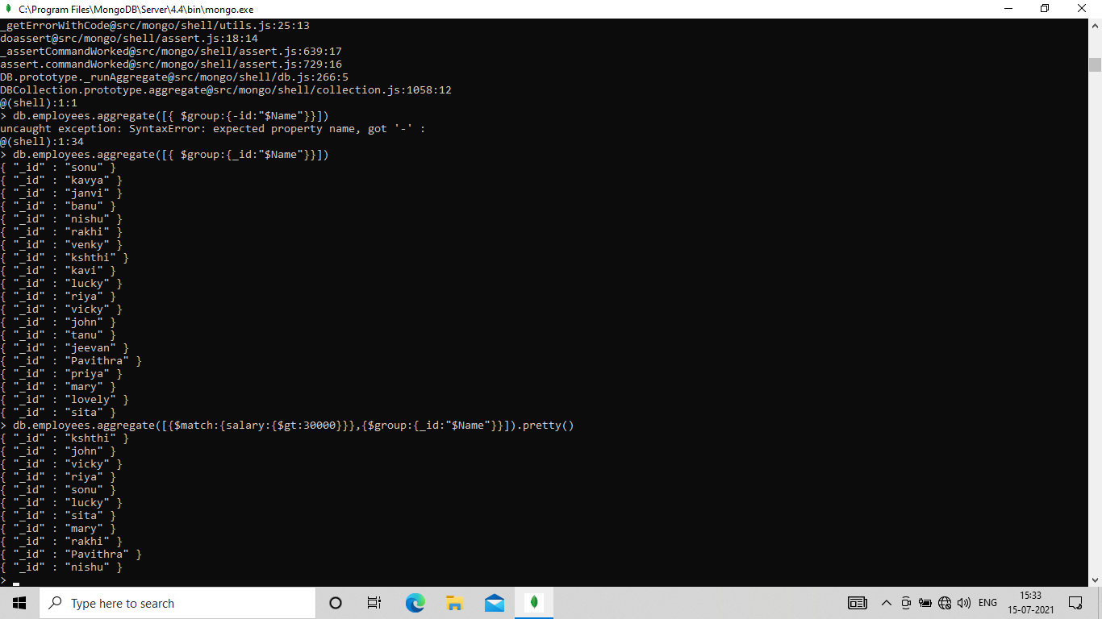

Aggregate pipelines

Slide 6
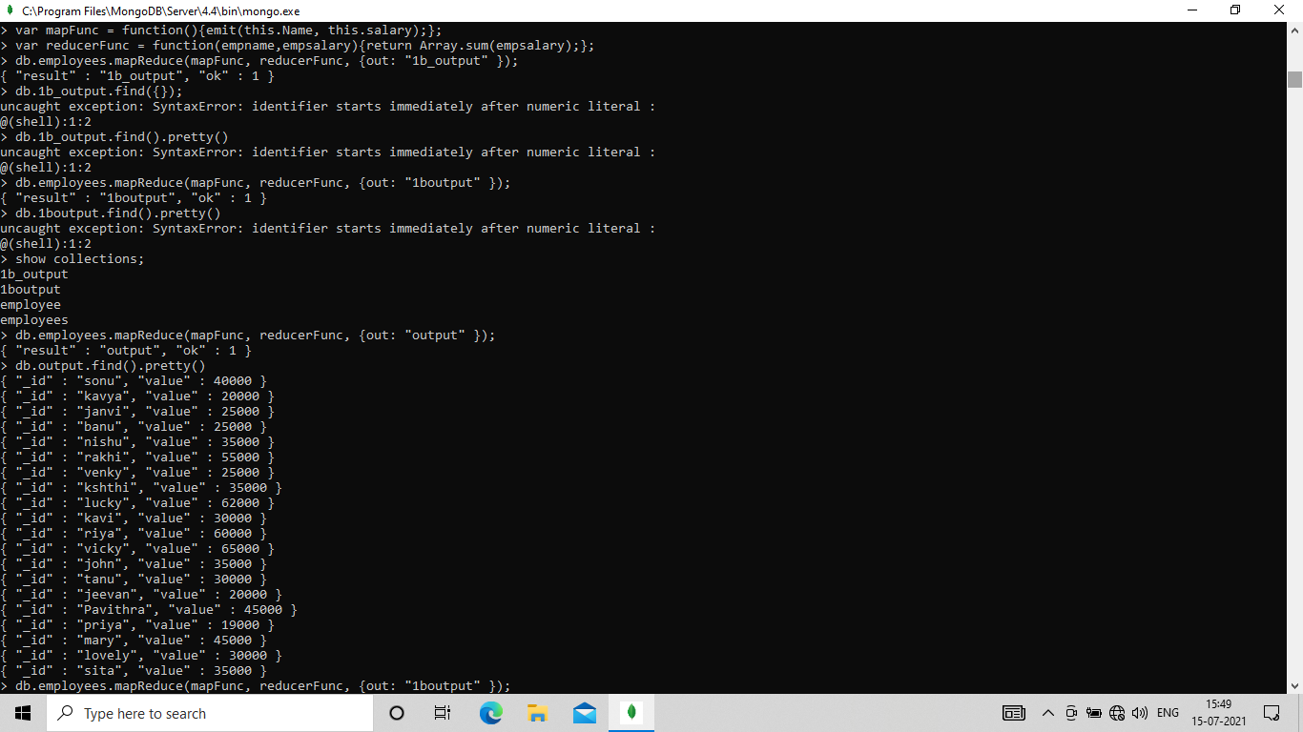
2) Demonstrate the map-reduce aggregate function of this dataset

Slide 7
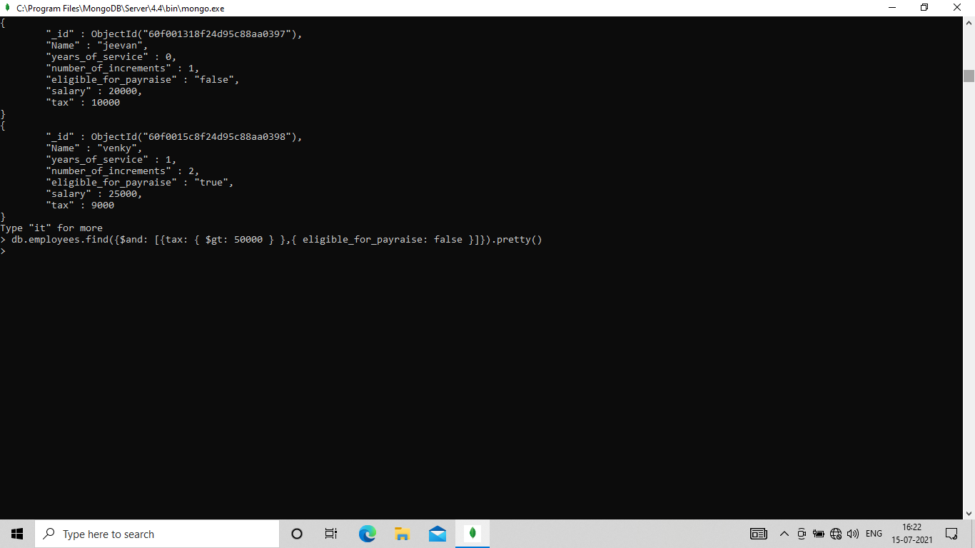
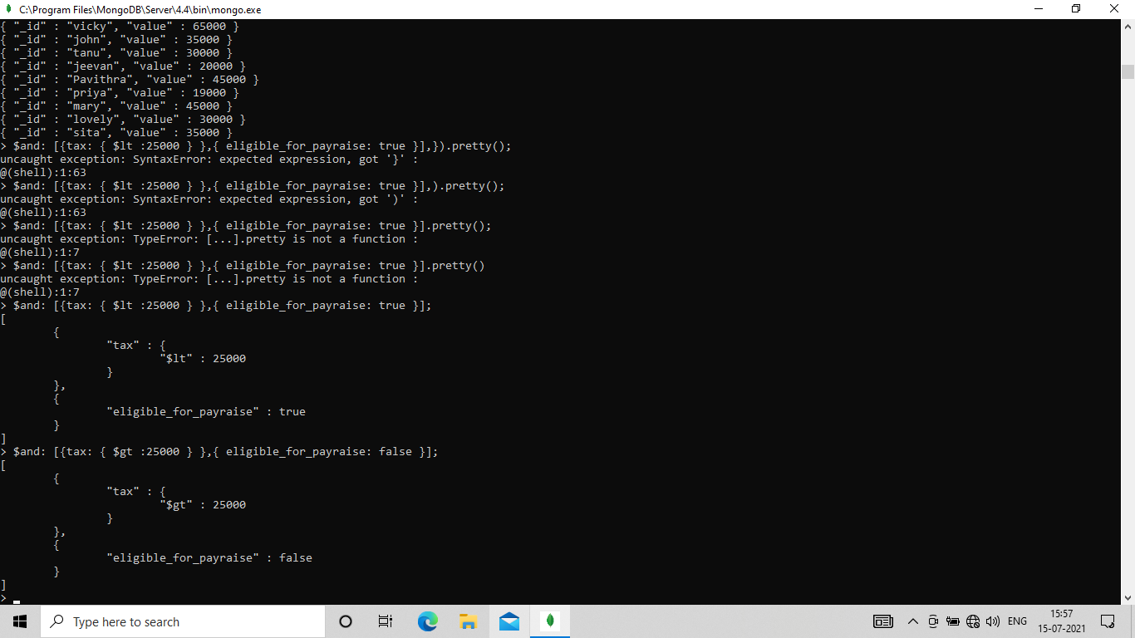
3) Find out all the employees, who are paying tax>50000 and are not eligible for pay raise.

Slide 8
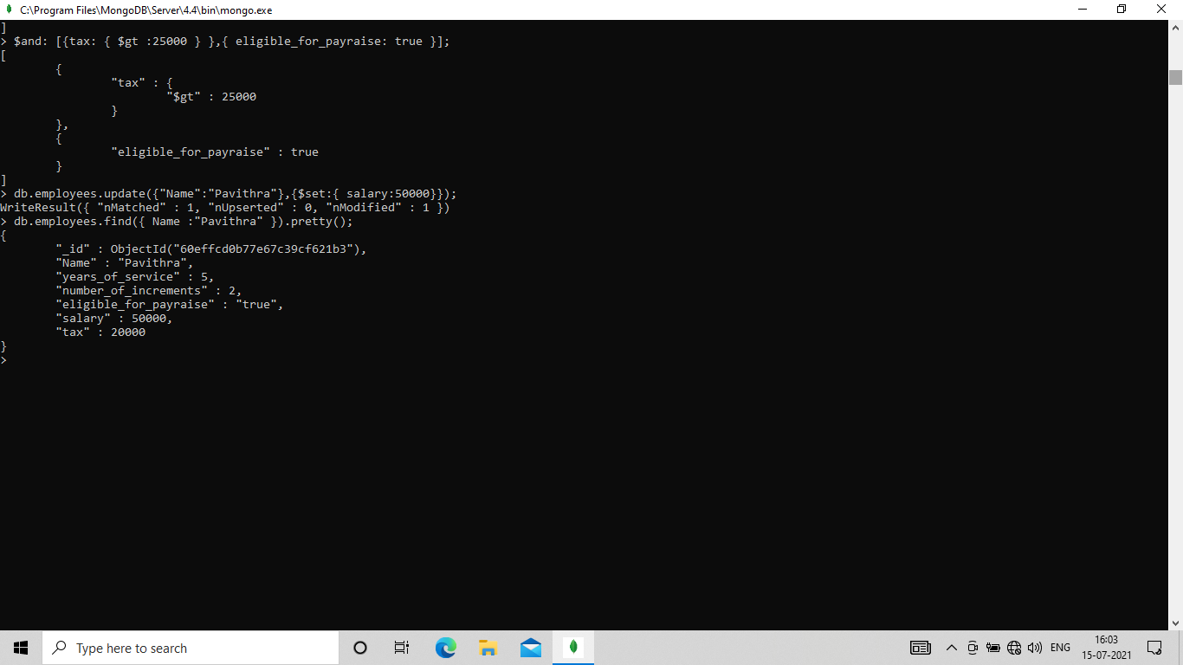
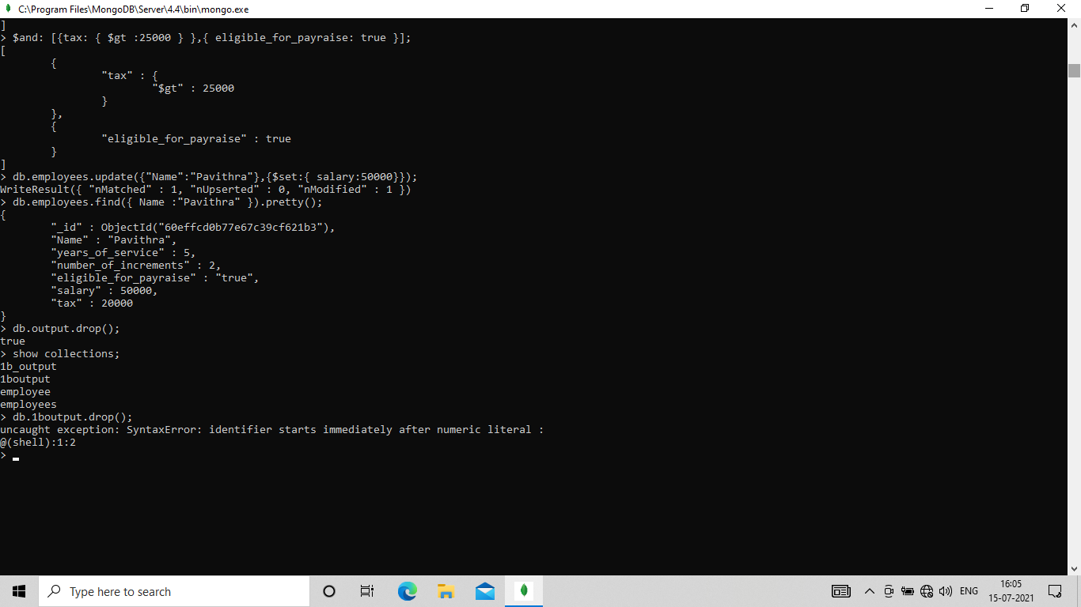
4) Demonstrate the alter and drop commands on this dataset.

Slide 9
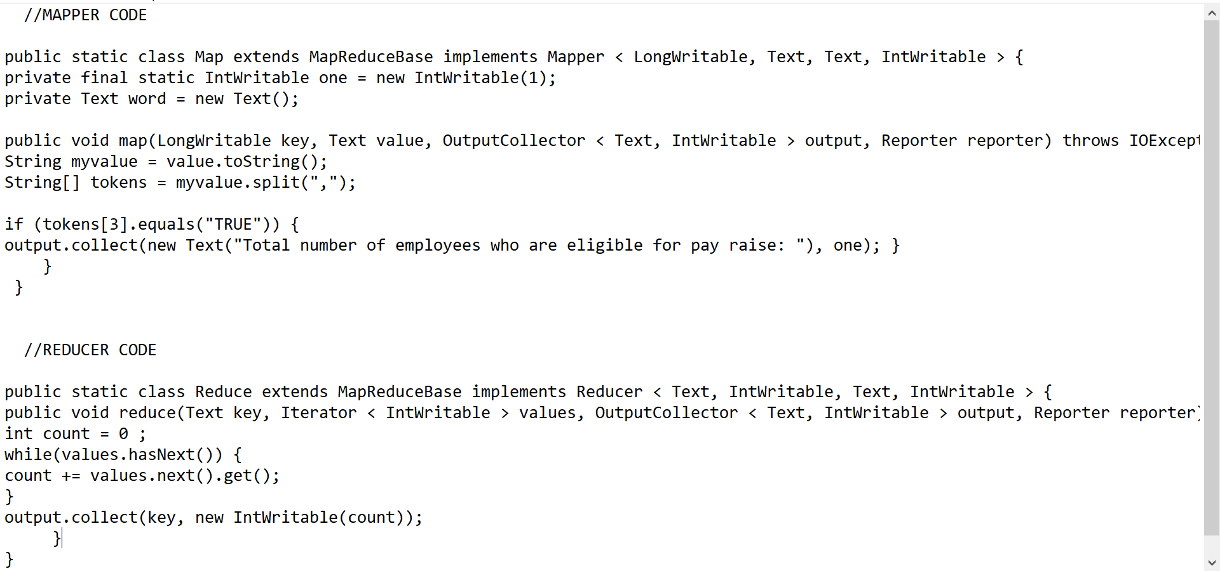
HADOOP-MAPREDUCE 1) FIND OUT THE TOTAL NUMBER OF EMPLOYEES WHO ARE ELIGIBLE FOR PAY RAISE.

Slide 10
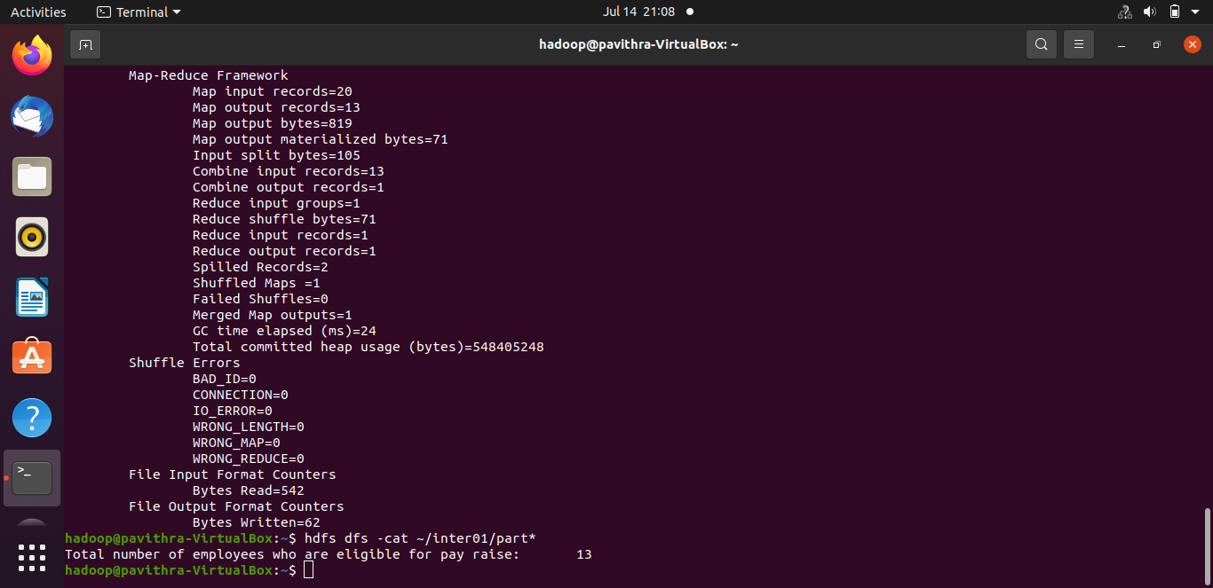
OUTPUT :

Slide 11
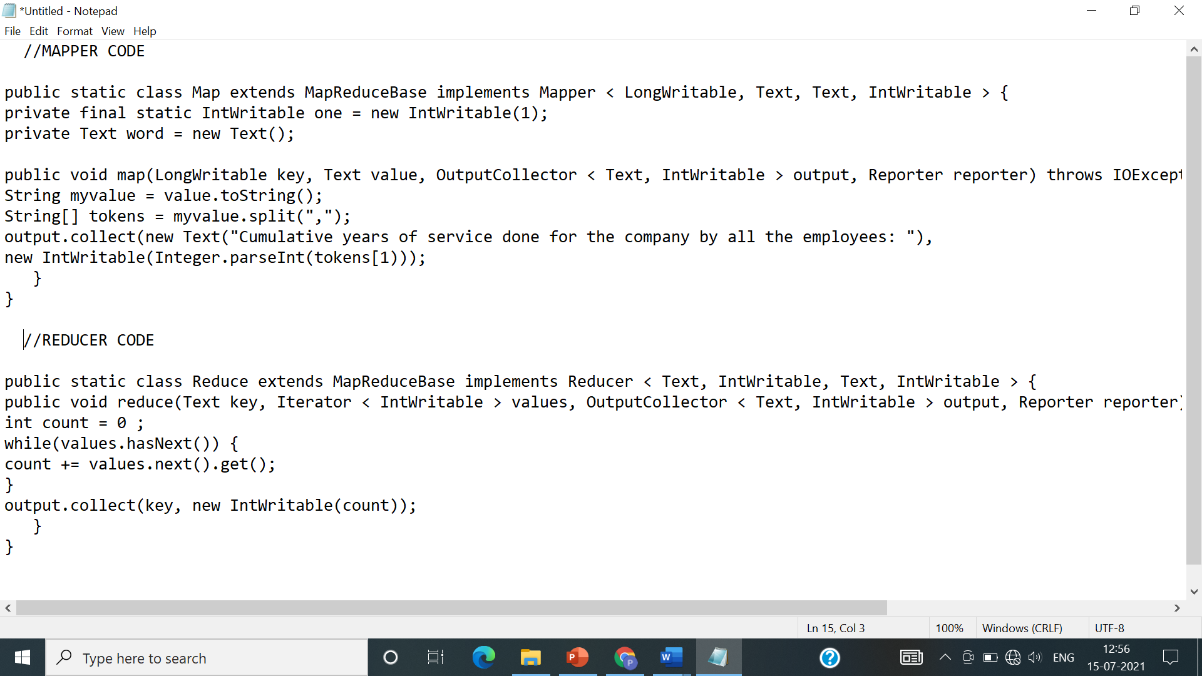
2) FIND OUT THE CUMULATIVE YEARS OF SERVICES DONE FOR THE COMPANY BY ALL THE EMPLOYEES.

Slide 12
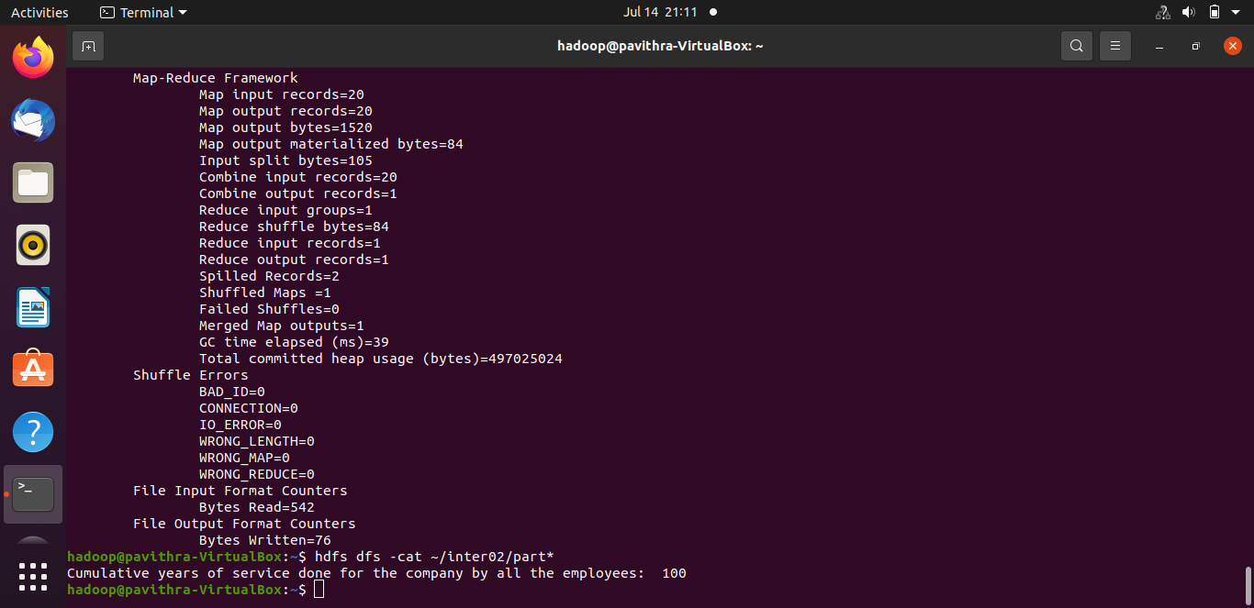
OUTPUT :

